Slide 1
Testing all components

Slide 2
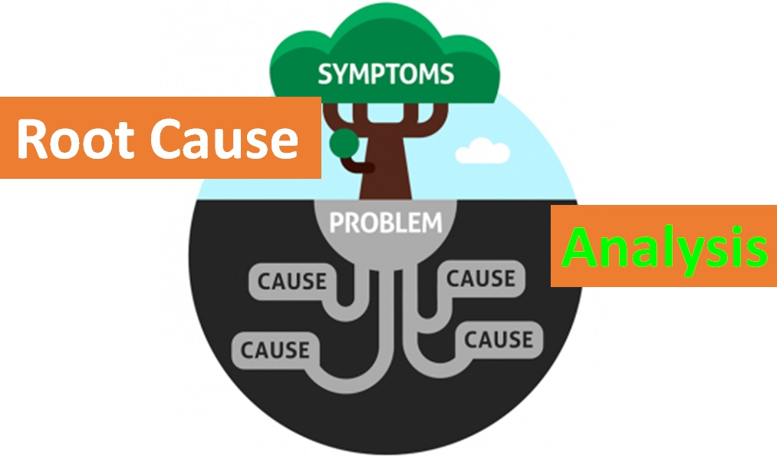
Previously
We can fix the bug, but why did it happen?
So that this type of mistake doesn’t happen again

Slide 3
Five whys
The 5 WHY analysis is a simple and very effective technique
By repeatedly asking the question WHY, you can peel away the layers of symptoms
Leads to the real, underlying Root Cause of a problem
5 is an arbitrary number, but it seems to work

Slide 4
More tests
Concept
Component
Product

Slide 5
Concept testing
Concept testing is when you ask people their thoughts on a concept or idea.
It’s a valuable tool to determining product-market fit.
By asking participants what they think about your concept, you’ll mitigate the risk of releasing a product that falls flat of customer expectations.
If we build a thing, will you buy it?
How do we find this out?

Slide 6
Components to Test
Software
Hardware
Data
Interfaces
Resulting service (final product)
Notes:
It is too simplistic to suggest that testing is only necessary to identify errors. Error free code could be inefficient or might not match the specifications set. However, it is the case that finding errors is the primary purpose of software testing.
Testing should follow a clear plan. This means that test data should have been prepared prior to implementation. It is common for some test data to be identified during the analysis stage of the development process.
Useful Article: https://www.tutorialspoint.com/software_testing_dictionary/index.htm

Slide 7
Test plan
It is too simplistic to suggest that testing is only necessary to identify errors.
Error free code could be inefficient or might not match the specifications set. However, it is the case that finding errors is the primary purpose of software testing.
Testing should follow a clear plan (Test Plan.) This means that test data should have been prepared prior to implementation.
It is common for some test data to be identified during the analysis stage of the development process.

Slide 8
Testing – two parts
Testing falls into two main categories
Functional testing:
What it does
Testing against the requirements specification
Verify each function and feature
Customer requirements
Non-functional testing:
How the product works
performance, usability, reliability, scalability, stress testing
Customer expectations

Slide 9
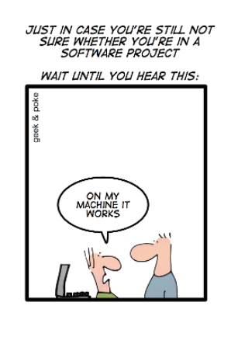
Integration testing
Integration testing is the phase in software testing in which individual software modules are combined and tested as a group
Integration tests determine if independently developed units of software work correctly when they are connected to each other.

Slide 10
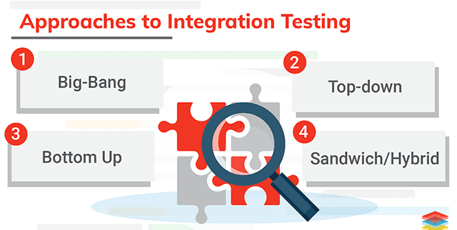
Integration testing
Software modules are integrated logically and tested as a group.
A typical software project consists of multiple software modules, coded by different programmers.
The purpose of this level of testing is to expose defects in the interaction between these software modules when they are integrated.
It is also termed as 'I & T' (Integration and Testing) or 'String Testing'.

Slide 11
Hardware Testing
Testing is needed to ensure that every component of a system is operating as it should, and that the system is performing exactly in accordance with the specific local requirements. A comprehensive structured testing program is one that ensures that all aspects of a system are tested.
Notes:
Software and hardware engineers alike have heard some form of this advice: “Build lots of prototypes; iterate as fast as you can.”
For those of us in the Hardware Industry, these prototypes can cost a lot of time and money. So while we should strive to iterate quickly, we must also get as much information as possible out of each round of prototypes to inform improvements in the next iteration. This is the purpose of hardware testing.
If you’re an Industrial or UX Designer, you might be most familiar with user testing. Different tests are beneficial at different stages and each test is an indispensable part of the hardware development process.
In this introductory article below, you'll find an overview of the different types of tests to consider at each major stage of hardware product development and share some best practices for building a testing schedule to help you get started.
Early Stage Testing
With even the crudest prototypes, you can do a lot of useful tests. There are 3 major test types you’ll want to build into your schedule during early stage development:
Usability tests to help refine the industrial design of the product
Material and finish tests to assess different options for durability
Critical components tests to analyze different mechanisms in isolation before a complete looks-like, works-like prototype is ready.
Useful Article: https://www.fictiv.com/hwg/test/hardware-testing-101

Slide 12
Hardware Testing
Software and hardware engineers alike have heard some form of this advice: “Build lots of prototypes; iterate as fast as you can.”
In the Hardware Industry, these prototypes can cost a lot of time and money.
Strive to iterate quickly, get as much information as possible out of each round of prototypes
Inform improvements in the next iteration.
This is the purpose of hardware testing.
Notes:
Software and hardware engineers alike have heard some form of this advice: “Build lots of prototypes; iterate as fast as you can.”
For those of us in the Hardware Industry, these prototypes can cost a lot of time and money. So while we should strive to iterate quickly, we must also get as much information as possible out of each round of prototypes to inform improvements in the next iteration. This is the purpose of hardware testing.
If you’re an Industrial or UX Designer, you might be most familiar with user testing. Different tests are beneficial at different stages and each test is an indispensable part of the hardware development process.
In this introductory article below, you'll find an overview of the different types of tests to consider at each major stage of hardware product development and share some best practices for building a testing schedule to help you get started.
Early Stage Testing
With even the crudest prototypes, you can do a lot of useful tests. There are 3 major test types you’ll want to build into your schedule during early stage development:
Usability tests to help refine the industrial design of the product
Material and finish tests to assess different options for durability
Critical components tests to analyze different mechanisms in isolation before a complete looks-like, works-like prototype is ready.
Useful Article: https://www.fictiv.com/hwg/test/hardware-testing-101

Slide 13
Hardware Testing
Early Stage Testing
With even the crudest prototypes, you can do a lot of useful tests. There are 3 major test types you’ll want to build into your schedule during early stage development:
Usability tests to help refine the industrial design of the product
Material and finish tests to assess different options for durability
Critical components tests to analyse different mechanisms in isolation before a complete looks-like, works-like prototype is ready.
Can you think of any hardware that you purchased recently?
e.g. headphones – user interface
Notes:
Software and hardware engineers alike have heard some form of this advice: “Build lots of prototypes; iterate as fast as you can.”
For those of us in the Hardware Industry, these prototypes can cost a lot of time and money. So while we should strive to iterate quickly, we must also get as much information as possible out of each round of prototypes to inform improvements in the next iteration. This is the purpose of hardware testing.
If you’re an Industrial or UX Designer, you might be most familiar with user testing. Different tests are beneficial at different stages and each test is an indispensable part of the hardware development process.
In this introductory article below, you'll find an overview of the different types of tests to consider at each major stage of hardware product development and share some best practices for building a testing schedule to help you get started.
Early Stage Testing
With even the crudest prototypes, you can do a lot of useful tests. There are 3 major test types you’ll want to build into your schedule during early stage development:
Usability tests to help refine the industrial design of the product
Material and finish tests to assess different options for durability
Critical components tests to analyze different mechanisms in isolation before a complete looks-like, works-like prototype is ready.
Useful Article: https://www.fictiv.com/hwg/test/hardware-testing-101

Slide 14
Interface Testing
Interface Testing is performed to evaluate whether systems or components pass data and control correctly to one another. It is to verify if all the interactions between these modules are working properly and errors are handled properly.
Notes:
What is Interface Testing?
Interface Testing is performed to evaluate whether systems or components pass data and control correctly to one another. It is to verify if all the interactions between these modules are working properly and errors are handled properly.
Interface Testing - Checklist
Verify that communication between the systems are done correctly
Verify if all supported hardware/software has been tested
Verify if all linked documents can be supported/opened on all platforms
Verify the security requirements or encryption while communication happens between systems
Check if a Solution can handle network failures between Web site and application server

Slide 15
Interface Testing
Interface Testing - Checklist
Verify that communication between the systems are done correctly
Verify if all supported hardware/software has been tested
Verify if all linked documents can be supported/opened on all platforms
Verify the security requirements or encryption while communication happens between systems
Check if a Solution can handle network failures between Web site and application server
Notes:
What is Interface Testing?
Interface Testing is performed to evaluate whether systems or components pass data and control correctly to one another. It is to verify if all the interactions between these modules are working properly and errors are handled properly.
Interface Testing - Checklist
Verify that communication between the systems are done correctly
Verify if all supported hardware/software has been tested
Verify if all linked documents can be supported/opened on all platforms
Verify the security requirements or encryption while communication happens between systems
Check if a Solution can handle network failures between Web site and application server

Slide 16
Product Testing
Product Testing; During the testing phase, testing groups will employ several methods to ensure that the product operates as expected. Your methods for testing might vary depending on the type of product you are building but the concepts remain very similar.
(also called consumer testing or comparative testing)
Product testing seeks to ensure that consumers can understand what products will do for them and which products are the best value.
Product testing is a strategy to increase consumer protection.
Notes:
Product testing, also called consumer testing or comparative testing, is a process of measuring the properties or performance of products.
The theory is that since the advent of mass production manufacturers produce branded products which they assert and advertise to be identical within some technical standard.
Product testing seeks to ensure that consumers can understand what products will do for them and which products are the best value. Product testing is a strategy to increase consumer protection by checking the claims made during marketing strategies such as advertising, which by their nature are in the interest of the entity distributing the service and not necessarily in the interest of the consumer. The advent of product testing was the beginning of the modern consumer movement.
Useful Article: https://learn.marsdd.com/article/product-testing-methods/

Slide 17
https://www.youtube.com/watch?v=t4kyRyKyOpo
TEDX on testing AI

Slide 18
Activity
You have been asked by your company to write training materials explaining what testing is and why it is important to new staff at the company.
Create some training materials for teaching new hires in an engaging way.
Notes:
Get the students to think about how they create the materials. They can use any method, Publisher, Word, Photoshop,
The only requirement is that they produce materials that can be delivered.
As a possible extension activity you could have them deliver this training to other students and get feedback.

Slide 19
task
Complete the testing documentation
Run the tests and find a bug (or many)
Apply root cause analysis to the bug
Fix the bug
Copy the test plan – for the tests that failed
Run the tests to confirm the application works
Confirm against spec - cards

Slide 20
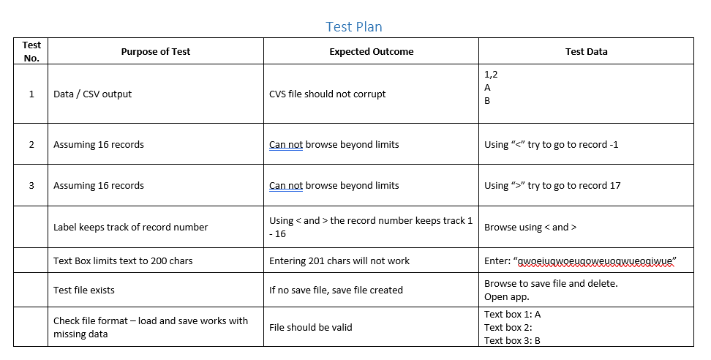
And started testing it – test plan

Slide 21
Things to check
Card info
Length check
Type checks
File format (escaping comma)
File exists?
Array length check – change array length – does it break the code?

